Slide 1

JAWAHARLAL NEHRU TECHNOLOGICAL UNIVERSITY HYDERABAD
UNIVERSITY COLLEGE OF ENGINEERING SCIENCE AND TECHNOLOGY
DEPARTMENT OF COMPUTER SCIENCE
Adversarial Deceptive Reinforcement Learning: Extending SAD-RL
through Co-Evolution and Adaptive Opponent Modelling
DISSERTATION STAGE-01
DISSERTATION WORK REVIEW-01
AUGUST - 2026
Guide:
Dr.M.Nagaratna
Professor, HOD of CSE Dept.
JNTUH UCESTH
Presented by:
DANDGE VAISHNAVI
22011P0514
CSE-IDP

Slide 2

Table of Contents
Abstract
Introduction
Existing Work
Problem Statement
Objective
Proposed Solution
Methodology
Conclusion
References

Slide 3
Abstract:
RL agents deployed in adversarial settings (defence, negotiation, competitive multi-agent games) face a core vulnerability i.e. predictability invites exploitation by rational adversaries who learn to anticipate their behaviour. SAD-RL addressed this by penalising a surrogate model's predictive accuracy to induce strategic opacity, but was validated only under simplified conditions one-sided deception, a static surrogate, and a single agent.This dissertation extends SAD-RL via symmetric deception (mutual penalties for co-evolutionary study), adaptive opponent modelling (online surrogate updates against non-stationary adversaries), and team deception (coordinated opacity across cooperative multi-agent teams). Through empirical evaluation across these extensions, the work aims to move SAD-RL from proof-of-concept toward a robust, deployable framework balancing competence with strategic opacity under real adversarial conditions.
3

Slide 4
Introduction:
Autonomous agents in competitive arenas can no longer be judged by task success alone; an opponent that decodes their patterns gains the upper hand, making behavioural transparency a liability.
SAD-RL tackled this by training agents to confuse a tracking model built to imitate them, but the proof rested on a narrow setup: one learner deceiving a passive tracker, an opponent that never adjusted, and no coordination with allies.
Real conflict rarely looks that clean genuine adversaries push back and refine their read over time, and many high-stakes tasks are handled by groups, none of which the original framework tested.
This work pushes SAD-RL into messier territory: two mutually evasive learners, a tracking model that keeps pace with a shifting target, and deception scaled to coordinated group behaviour to test whether engineered unpredictability survives real adversarial contact.
3

Slide 5
Existing Work:
Surrogate-Augmented Deception in Reinforcement Learning (SAD-RL):
Authors: Joe Shymanski, Scott Nivison, Sandip Sen
Core Mechanism:
Agent trains: Learns a policy toward its task objective.
Surrogate model observes: A separate model tries to predict the agent's behaviour.
Accuracy is penalised: The agent is rewarded for degrading the surrogate's predictive accuracy.
Strategic opacity emerges: The agent learns to remain effective while becoming harder to model.
Demonstrated in the original work:
Penalising surrogate accuracy induces strategic opacity
Deceptive agents retain task competence
Effective against a single, static opponent model.
5

Slide 6
Problem Statement:
To extend the SAD-RL framework and evaluate whether trained strategic opacity persists when both agents in an adversarial pair are incentivised to deceive, the opponent's surrogate model continuously adapts, and deception must be coordinated across a cooperative multi-agent team.
6

Slide 7
Objective:
To extend the SAD-RL (Surrogate-Augmented Deception in Reinforcement Learning) framework beyond its original single-sided, static-adversary formulation by enabling agents to learn and study deception under realistic, co-adaptive conditions where opponents also learn, surrogate models are diverse and dynamic, and deception can emerge across multiple agents and domains.
6

Slide 8
Proposed Solution:
Adaptive Opponent Modelling:
Online surrogate updates against non-stationary, counter-adapting agents
Symmetric Deception: Both agents receive surrogate penalties; study co-evolutionary dynamics
Team Deception: Multiagent teams coordinate collective, joint deception strategies
4

Slide 9
Symmetric Deception
Adaptive Opponent Modelling
Team Deception
If both agents in an adversarial pair are simultaneously rewarded for evading each other's surrogate models, what equilibrium behaviours emerge?
Mutual Surrogate Penalty
Co-Evolutionary Training
Equilibrium Analysis
Does strategic opacity persist when the opponent's surrogate model is continuously updated online, rather than fixed at training time?
Online Surrogate Updates
Non-Stationary Adversaries
Robustness Testing
Can multiple cooperating agents coordinate a collective deception strategy that is harder to model than any individual agent's behaviour?
Multiagent Extension
Collective Coordination
Emergent Role Division
7

Slide 10
Methodology:
Baseline Reproduction
Adaptive Surrogates
Evaluation Suite
Reproduce original SAD-RL results as a control condition.
Introduce online-updating surrogate models against the trained agents
Compare task competence, surrogate error, and exploitability across all conditions.
Symmetric Setup
Team Formulation
Implement mutual surrogate penalties in a two-agent adversarial environment.
Extend the environment and reward structure to cooperative multi-agent teams.
10

Slide 11
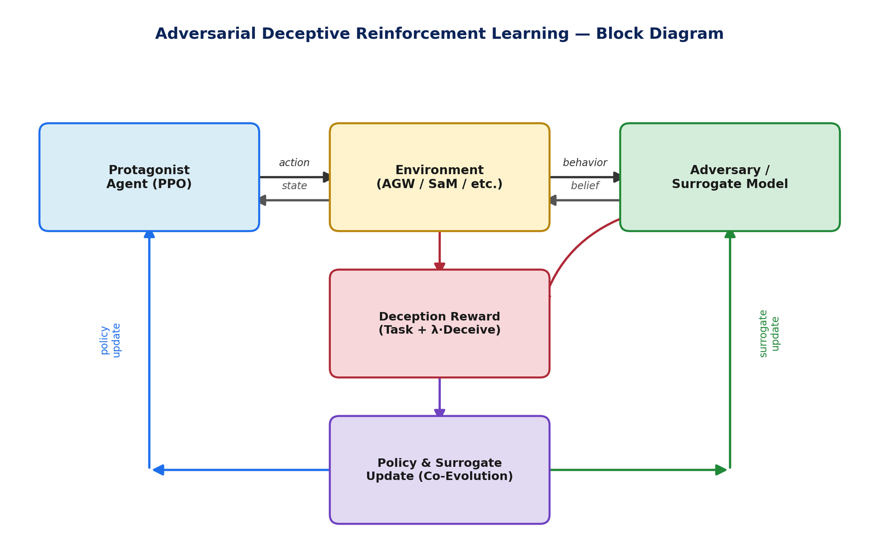

Slide 12
Conclusion:
SAD-RL demonstrated that strategic opacity can be trained into RL agents without sacrificing task competence — but only under simplified conditions: one-sided, static, and single-agent. This dissertation proposes to close those gaps through symmetric deception, adaptive opponent modelling, and team deception, testing whether opacity survives mutual adaptation, learning adversaries, and multi-agent coordination. The goal is to move SAD-RL from a proof-of-concept into a framework robust enough for deployment in genuinely adversarial, real-world settings.
11

Slide 13
References:
[1] Y. Kim, A. Benvenuti, B. Chen, M. Karabag, A. Kulkarni, N. D. Bastian, U. Topcu, and M. Hale, "Deceptive sequential decision-making via regularized policy optimization," arXiv:2501.18803, 2025.
[2] Y. Kim, A. Benvenuti, B. Chen, M. Karabag, A. Kulkarni, N. D. Bastian, U. Topcu, and M. Hale, "Defining and measuring deception in sequential decision systems: Application to network defense," in Proc. IEEE Mil. Commun. Conf. (MILCOM), 2024, pp. 1–6.
[3] T. Bansal, J. Pachocki, S. Sidor, I. Sutskever, and I. Mordatch, "Emergent complexity via multi-agent competition," in Proc. Int. Conf. Learn. Represent. (ICLR), 2018.
[4] P. Hernandez-Leal, M. Kaisers, T. Baarslag, and E. Munoz de Cote, "A survey of learning in multiagent environments: Dealing with non-stationarity," arXiv:1707.09183, 2017.
[5] J. Foerster, R. Y. Chen, M. Al-Shedivat, S. Whiteson, P. Abbeel, and I. Mordatch, "Learning with opponent-learning awareness," in Proc. Int. Conf. Auton. Agents Multiagent Syst. (AAMAS), 2018, pp. 122–130.
[6] R. Lowe, Y. Wu, A. Tamar, J. Harb, P. Abbeel, and I. Mordatch, "Multi-agent actor-critic for mixed cooperative-competitive environments," in Adv. Neural Inf. Process. Syst. (NeurIPS), vol. 30, 2017, pp. 6379–6390.
[7] J. Lin, K. Dzeparoska, S. Q. Zhang, A. Leon-Garcia, and N. Papernot, "On the robustness of cooperative multi-agent reinforcement learning," arXiv:2003.03722, 2020.
[8] J. Schulman, F. Wolski, P. Dhariwal, A. Radford, and O. Klimov, "Proximal policy optimization algorithms," arXiv:1707.06347, 2017.
12

Slide 14

Thank You

